Slide 1
Your Team Development & Training

Slide 2
5 courses for the price of 4
Half Day Courses Covering
1.Leadership styles
2.Goal setting
3.Team working
4.Motivation
5.Sharing success
Learning Outcomes
The benefits of leading over managing
Good versus bad leadership styles
How to bring a plan to life
Learn how to communicate clear goals
Getting the most out your team
How to use body language and speech to motivate people
Actively recognise and celebrate success

Slide 3
Training Needs Performance Indicators
We conduct a Training Needs Analysis of each participant prior to the attendance of the course.
This ensures the content discussions and the work shop objectives meet both the individual and their business needs
We discuss the performance indicators of the business and agree what the outcome from the course needs to be.
The resulting action plan for each participant is therefore supported from the outset by the business they work in

Slide 4
A Selection of Other courses available
Succession Planning
Stress Management
Work Place Culture
Colleague Engagement
Self Belief
High Performing Teams
Collaborative Working
New to Managing
Courses from £150 per attendee
CBT Group discount for One Company, minimum of 5 to maximum of 15 attendees.
Course Cost Only £400 for half day, £750 for full day.
Half day and full day events

Slide 5
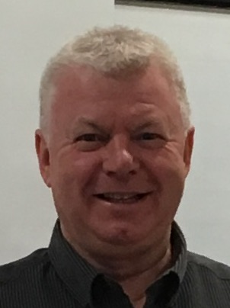
Would you like more information?
Brian Forbes
Alison Carlin
Bob Penman
Brian@evokeleadership.co.uk
Mobile 07784-909456
Bob@evokeleadership.co.uk
Mobile 07908-000025
Alisoncarlin@cbtltd.org
Tele: 01698-262753

